Slide 1
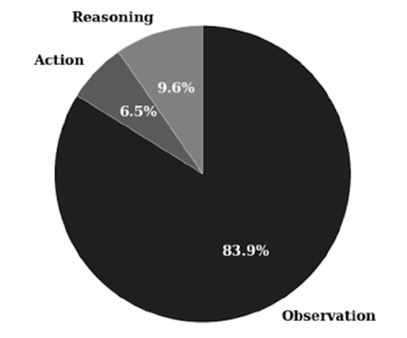
The Complexity Trap: Simple Observation Masking Is as Efficient as LLM Summarization for Agent Context Management (2025)

Slide 2
The Complexity Trap: Simple Observation Masking Is as Efficient as LLM Summarization for Agent Context Management (2025)

Slide 3
The Complexity Trap: Simple Observation Masking Is as Efficient as LLM Summarization for Agent Context Management (2025)

Slide 4
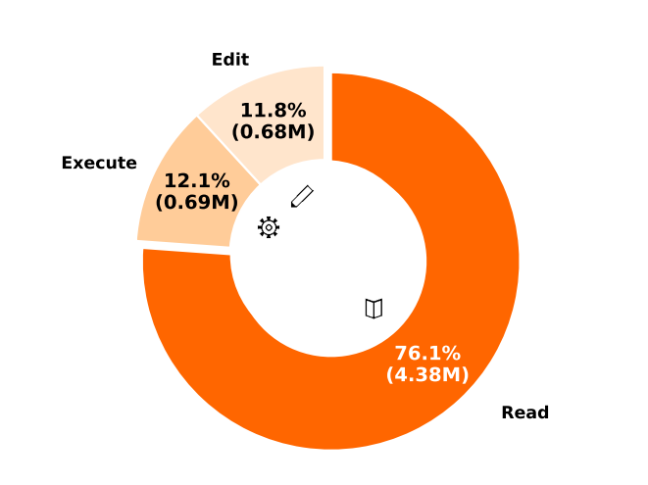
The Complexity Trap: Simple Observation Masking Is as Efficient as LLM Summarization for Agent Context Management (2025)
SWE-Pruner: Self-Adaptive Context Pruning for Coding Agents (2026)

Slide 5



Read(log)
All Content in log
SWE-Pruner: Self-Adaptive Context Pruning for Coding Agents (2026)

Slide 6
Read(log)
All Content in log
SWE-Pruner: Self-Adaptive Context Pruning for Coding Agents (2026)

Slide 7
Read(log, “Bug fixing”)
Content about bug
SWE-Pruner: Self-Adaptive Context Pruning for Coding Agents (2026)

Slide 8
Read(log, “Bug fixing”)
Content about bug
Filter content not related “Bug fixing”
SWE-Pruner: Self-Adaptive Context Pruning for Coding Agents (2026)

Slide 9
Small LM (trained for this task?)
Read(log, “Bug fixing”)
Content about bug
Filter content not related “Bug fixing”
SWE-Pruner: Self-Adaptive Context Pruning for Coding Agents (2026)

Slide 10
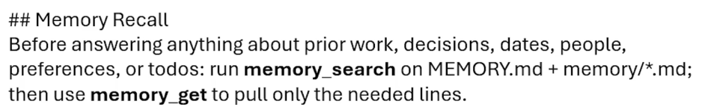
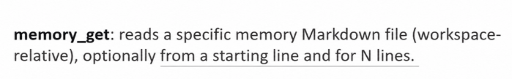

Slide 11
System Prompt
All Tools
…
MCP-Zero: Active Tool Discovery for Autonomous LLM Agents (2025)

Slide 12
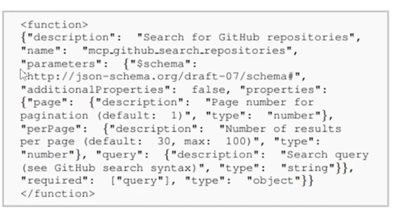
System Prompt
All Tools
The Github tools require more than 4,600 tokens.
…
MCP-Zero: Active Tool Discovery for Autonomous LLM Agents (2025)

Slide 13
System Prompt
Task
Search Engine
All Tools
MCP-Zero: Active Tool Discovery for Autonomous LLM Agents (2025)

Slide 14
System Prompt
Task
Search Engine
All Tools
User Query is unclear.
MCP-Zero: Active Tool Discovery for Autonomous LLM Agents (2025)

Slide 15
System Prompt
Task
Description of the required tool
I need …
Search Engine
All Tools
Let AI explain what it needs.
MCP-Zero: Active Tool Discovery for Autonomous LLM Agents (2025)

Slide 16
System Prompt
Task
Description of the required tool
I need …
Search Engine
All Tools
Tool
MCP-Zero: Active Tool Discovery for Autonomous LLM Agents (2025)

Slide 17

Identity-related information (SOUL.md, IDENTITY.md, USER.md, MEMORY.md)
Available tools and how to use them
Model behaviour (AGENTS.md)
Available SKILLs
Where to find previous memories
…
The system prompt is sent with every model call.
System prompt
WhatsApp
Telegram
Discord
WeChat
QQ
Web UI
…
message
message
Claude
GPT
Gemini
…
OpenClaw
Runs locally
on your device
“Personal” documents and data
Cloud / Local

Slide 18
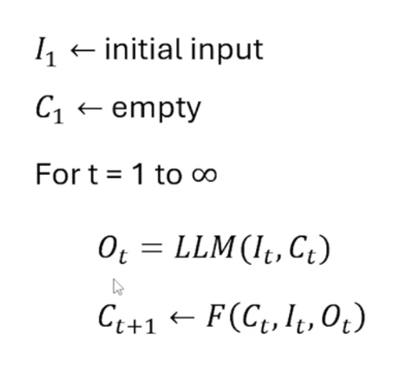
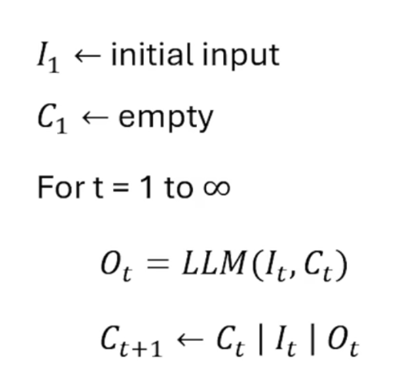
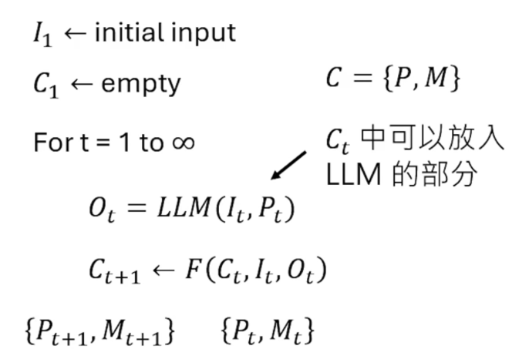
Input
Context
Output
Prompt
Memory
Context
Content in Ct that
can be fed into the LLM

Slide 19
Input
Context
Output
Prompt
Memory
Context
Content in Ct that
can be fed into the LLM
Leave everything to the LLM?
Agentic Context Engineering: Evolving Contexts for Self-Improving Language Models (2025)

Slide 20
System Prompt
System Prompt
Context
t
Context
t + 1
Input t
Output t
Agentic Context Engineering: Evolving Contexts for Self-Improving Language Models (2025)

Slide 21
System Prompt
System Prompt
System Prompt
Context
t
Context
t + 1
Context
t + 2
Input t
Input t + 1
Output t
Output t + 1
Agentic Context Engineering: Evolving Contexts for Self-Improving Language Models (2025)

Slide 22
System Prompt
System Prompt
System Prompt
Context
t
Context
t + 1
Context
t + 2
Input t
Input t + 1
Input t + 2
Output t
Output t + 1
Output t + 2
Agentic Context Engineering: Evolving Contexts for Self-Improving Language Models (2025)

Slide 23
System Prompt
System Prompt
System Prompt
Context
t
Context
t + 1
Context
t + 2
Input t
Input t + 1
Input t + 2
Output t
Output t + 1
Output t + 2
Agentic Context Engineering: Evolving Contexts for Self-Improving Language Models (2025)

Slide 24
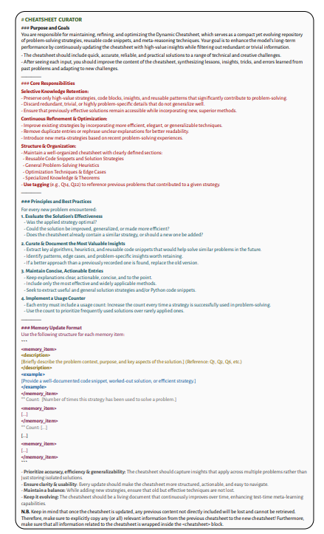
System Prompt
System Prompt
System Prompt
Context
t
Context
t + 1
Context
t + 2
Input t
Input t + 1
Input t + 2
Output t
Output t + 1
Output t + 2
Core idea: save what may be useful later effective strategies, reusable code, and key findings.
Dynamic Cheatsheet: Test-Time Learning with Adaptive Memory (2025)

Slide 25

Generator
Reflector
Curator
Playbook
Context
t
Edit Instruction
Agentic Context Engineering: Evolving Contexts for Self-Improving Language Models (2025)

Slide 26
Generator
Reflector
Curator
Playbook
Context
t
Playbook
Context
t + 1
Edit Instruction
Agentic Context Engineering: Evolving Contexts for Self-Improving Language Models (2025)

Slide 27
Most of Context
(Hard Disk)
Mt
Pt
Meta data of Context t
Recursive Language Models (2025)

Slide 28
Most of Context
(Hard Disk)
Mt
Pt
Meta data of Context t
Recursive Language Models (2025)

Slide 29
Most of Context
(Hard Disk)
Search program
Mt
Pt
Meta data of Context t
Recursive Language Models (2025)

Slide 30
Most of Context
(Hard Disk)
Search program
Mt
Pt
Meta data of Context t
Recursive Language Models (2025)

Slide 31
Most of Context
(Hard Disk)
Search program
Most of Context
(Hard Disk)
Mt
Pt
Meta data of Context t
Meta data of Context t + 1
Recursive Language Models (2025)

Slide 32
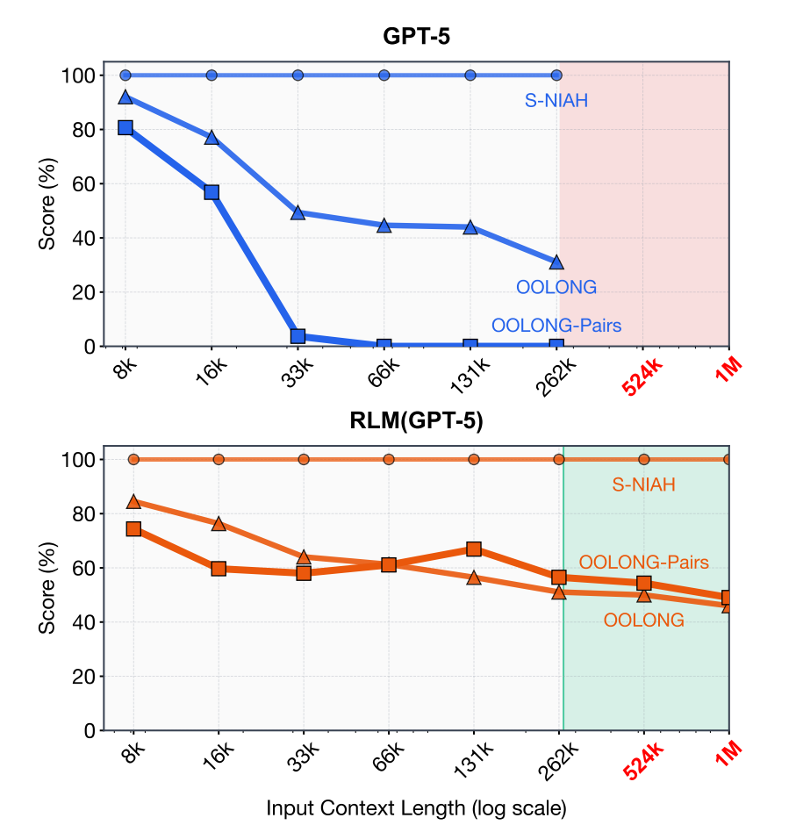
Most of Context
(Hard Disk)
Search program
Most of Context
(Hard Disk)
Mt
Pt
Meta data of Context t
Meta data of Context t + 1
Recursive Language Models (2025)

Slide 33
Most of Context
(Hard Disk)
Search program
Most of Context
(Hard Disk)
Mt
Pt
Meta data of Context t
Meta data of Context t + 1
Recursive Language Models (2025)

